Slide 1
Data modelling – Part 1 Dr Mariana Rocha School of Computer Science
CMPU 2007 Databases 1, Lecture 2

Slide 2
Models - Purpose
The objective of data modelling is to produce a model that:
can be understood by an end user,
contains sufficient detail for a developer to build a physical database.

Slide 3

Data Models
Model of system in client’s mind
Logical Model
Database
server
Relational - Physical Model
Tables on disk
Notes:
Data Models
Models are a cornerstone of design. Engineers build a model of a car to work out any details before putting it into production. In the same manner, system designers develop models to explore ideas and improve the understanding of database design.

Slide 4
The Entity-Relationship Model
Relational databases use ERD models to represent the database considering:
Entities involved (things about which data is to be stored)
Relationships (or associations) among those entities and
Attributes (properties) of both the entities and their relationships

Slide 5
ERD
Used to define the structure of entities and the pattern of relationships between them.
When we implement that structure and pattern in a physical database, then we can populate it with data about the entity.
The ERD is implementation-independent
You can implement the same conceptual model in any relational database (PostgreSQL, Oracle etc.)
There may be small implementation differences (for example, data types), but the structure and relationships will be the same.

Slide 6
ERD - entities
The entities in a relational database are the tables.
There are two types of entities:
Strong entities: exist independently
Weak entities: depend on another entity

Slide 7
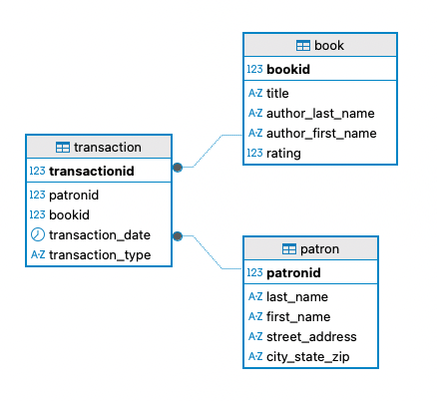
ERD – Strong entity (transaction)

Slide 8
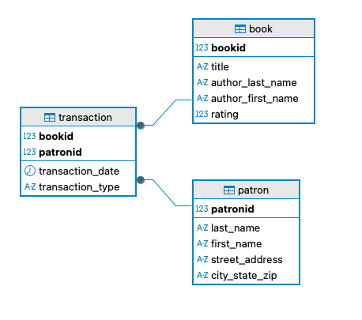
ERD – Weak entity (transaction)

Slide 9
Step 1: Find the entities
Discover the entities about which you need to store data
Conduct Interviews and Document analysis
Ask what things they would like to capture, store, produce information about
Study forms, files, reports
Identify key words
Some identify event entities e.g. orders, payments etc.
Look for relationships between things
Find the pieces of data required and then group them into entities
Give entities meaningful names
Name with NOUNS
Define them in business terms

Slide 10
Example
Local county councils organise football competitions for school children.
Each local county council has a unique identifier and a name.
Competitions are held on different dates for different age groups with fees and prizes.
Each competition has a unique ID and a name.
There are lots of teams who compete.
Each team has a unique identifier, a name and an age group.
What are the entities?

Slide 11
Step 2: Allocate the attributes to entities
For each entity
Identify its attributes
Decide on a name for each (starting with lowercase)
Identify the correct data type and size required for each

Slide 12
Data types Logical
These are different to the physical datatypes
Characters or character strings (CHAR, VARCHAR)
Numeric Data
Data and time
Binary
Each attribute can only be of one data type
At design stage, you need to clearly identify the data type
It will then be translated into the correct datatype in the relational model so that it can be correctly implemented in a physical database when it is built from the design

Slide 13
Our Example
Local county councils organise football competitions for school children.
Each local county council has a unique identifier and a name.
Competitions are held on different dates for different age groups with fees and prizes.
Each competition has a unique ID and a name.
There are lots of teams who compete.
Each team has an ID, a name and an age group.
What are the attributes and their datatypes?

Slide 14
Our Example – What are the datatypes?
Each competition has
a unique ID (INT)
a name VARCHAR (40)
an entrance fee (which could store values up to 999.99) NUMERIC Precision 5, scale 2
a prize (which could store values up to 9999.99)
NUMERIC Precision 6, scale 2
the date on which the competition will happen (DATE)
Each council has
a unique ID (INT)
a name VARCHAR (40)
Each team has
a unique numeric ID INT
a name VARCHAR (40)
an age group INT

Slide 15
Step 3: Entity Constraints
Identify relevant value constraints on the attributes we can define at this stage
Constraints are rules that the data must follow to belong to a given entity.
Constraints are rules that the data must follow to be removed from a given entity.
Constraints enforce rules.
Ensures that whoever uses your data can be confident that the data will be consistent.

Slide 16
Constraints
ENTITY Integrity
Primary Key
REFERENTIAL Integrity
Foreign Key
DOMAIN Integrity
Datatype
Value Constraints
Define
if NULL values are disallowed
if UNIQUE values are required
and if only a certain set of values is allowed in a column.

Slide 17
NULL and NOT NULL
What is NULL?
Null is a non-value
It is not zero, it is not blank
NULL is a special name to denote a valueless column in a row.
If the column must contain a non-null value, the constraint ‘NOT NULL’ should be put on it.
This will prevent a user from adding a row that has no value for this column
The default is NULL. Unless you specify NOT NULL, nulls will be allowed.

Slide 18
Our Example – Entity Integrity
Each council must have
a unique numeric ID (INT)
Each competition must have
a unique numeric ID (INT)
Each team must have
a unique numeric ID (INT)

Slide 19
Key Constraints – Primary Key
For each entity
Identify which attribute will uniquely identify it. Three rules should be considered:
Value of key should not change over lifetime of entity
Value of key cannot be null
Value must be unique
Possibilities:
Reuse attributes
Invent a key
Combine a number of attributes

Slide 20
Key Constraints – Primary Key
Is an attribute or a set of attributes that uniquely identify a specific instance of an entity.
Every entity in the data model must have a primary key whose values uniquely identify instances of the entity.
Enforce entity integrity by uniquely identifying entity instances.

Slide 21
Key Constraints – Primary Key
Sometimes an entity will have more than one attribute that can serve as a primary key.
Any key or minimum set of keys that could be a primary key is called a candidate key.
Once candidate keys are identified, choose one, and only one, primary key for each entity.
Choose the identifier most commonly used by the user as long as it conforms to the properties required of a primary key.
Candidate keys which are not chosen as the primary key are known as alternate keys.

Slide 22
Step 4: Define the Relationships
A relationship is a link or an association between two entities which is meaningful for the organisation
For example, a Customer ‘places’ an Order
A relationship is a natural business association that exists between one or more entities.
Relationships can represent an event or a logical affinity
Relationships usually arise because of
association - a Customer ‘places’ an Order
structure - an Order ‘consists’ of Order-Lines
All relationships that are usable only involve two entities.

Slide 23
We relate entities to each other in quantitative terms (Cardinality).
The relationship is defined by the number of rows in one table that are related to the number of rows in another table.
All relationships are bi-directional, so cardinality must be defined in both directions for every relationship.
Also called complexity or degree of the relationship.
Examples
A customer places one or more orders
An order is placed by one
An order consists of one or more products
A product appears on zero, one or more orders
A student enrols on one or more modules
Notes:
Bold, underlined verb phrases define business relationships between two entities

Slide 24
Id | Name | Programme
C1234 | Mary | TU850
C1235 | Andrea | TU856
C1245 | John | TU858
Id | Name | Lecturer
CMPU2007 | Databases 1 | Mariana
PROG1001 | Prog Paradigms | Mariana
CMPU1031 | Web Dev 1 | Mariana
Notes:
Entities don’t exist in isolation. The things they represent interact with and impact one another to support business mission so we introduce the concept of a relationship

Slide 25
Step 4: Define the relationships
Define the type and optionality of each relationship
How many instances of each entity are involved?
Does the relationship have to exist for all instances?
Define the Cardinality/Complexity/Degree of relationships
Need to ask questions about the relationship
Must a customer exist for every order?
Must an order exist for every customer?
Must an order always include a product?
How many products can an order include?
Must a product appear on an order?
Notes:
Entities don’t exist in isolation. The things they represent interact with and impact one another to support business mission so we introduce the concept of a relationship

Slide 26
One-to-one (1:1)
In a one-to-one relationship, a single record in Table A is associated with a single record in Table B, and vice versa. This means that for every instance of Table A, there is exactly one corresponding instance in Table B.
Notation: Typically represented by a line connecting the two entities, with a "1" at both ends.
For example, a person has one passport, and each passport belongs to one person.
Notes:
Entities don’t exist in isolation. The things they represent interact with and impact one another to support business mission so we introduce the concept of a relationship

Slide 27
One-to-many (1:N)
In a one-to-many relationship, a single record in Table A can be associated with multiple records in Table B. Still, a record in Table B can only relate to one record in Table A.
Notation: Represented by a line connecting the two entities, with a "1" at the Table A end and an "N" (or "M") at the Table B end.
A library can have many books, but each book belongs to only one library.
Notes:
Entities don’t exist in isolation. The things they represent interact with and impact one another to support business mission so we introduce the concept of a relationship

Slide 28
Many-to-one (M:1)
This is essentially the reverse of a one-to-many relationship. Many records in Table B can relate back to a single record in Table A, but a record in Table A can relate to many records in Table B.
Notation: Represented similarly to the one-to-many notation, with an "N" (or "M") at the Table B end and a "1" at the Table A end.
Many students can belong to one classroom.
Notes:
Entities don’t exist in isolation. The things they represent interact with and impact one another to support business mission so we introduce the concept of a relationship

Slide 29
Many-to-many (M:N)
In a many-to-many relationship, multiple records in Table A can relate to multiple records in Table B, and vice versa. This relationship usually requires a junction table to facilitate the connection.
Notation: Represented by a line connecting the two entities, with an "M" (or "N") at both ends.
Students can enrol in multiple courses, and each course can have multiple students enrolled.
Notes:
Entities don’t exist in isolation. The things they represent interact with and impact one another to support business mission so we introduce the concept of a relationship

Slide 30
Resolving Many-to-many
Many-to-many relationships are prone to error as managing a large number of rows that relates to another large number of rows can be challenging
We resolve many-to-many relationships by introducing a junction table, also known as a weak entity.
Notes:
Entities don’t exist in isolation. The things they represent interact with and impact one another to support business mission so we introduce the concept of a relationship

Slide 31
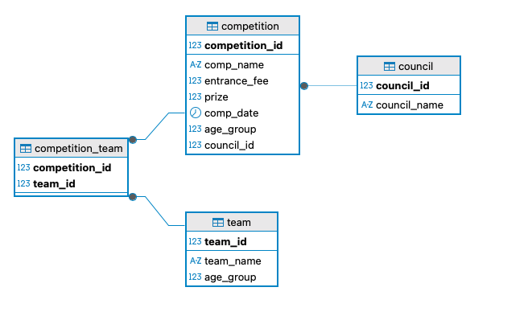
Step 4: Define the relationships
Notes:
Entities don’t exist in isolation. The things they represent interact with and impact one another to support business mission so we introduce the concept of a relationship

Slide 32
Foreign Key
When one table needs to be related to another table, you must include a common attribute(s).
The common attribute(s) will be the primary key in one table and the foreign key in another table.
Foreign keys enforce referential integrity – the values should be the same in both tables for that specific attribute.

Slide 33
Foreign Key
A foreign key value must match an existing value in the parent table or be NULL.
Foreign keys are based on data values and are purely logical, rather than physical, pointers.

Slide 34
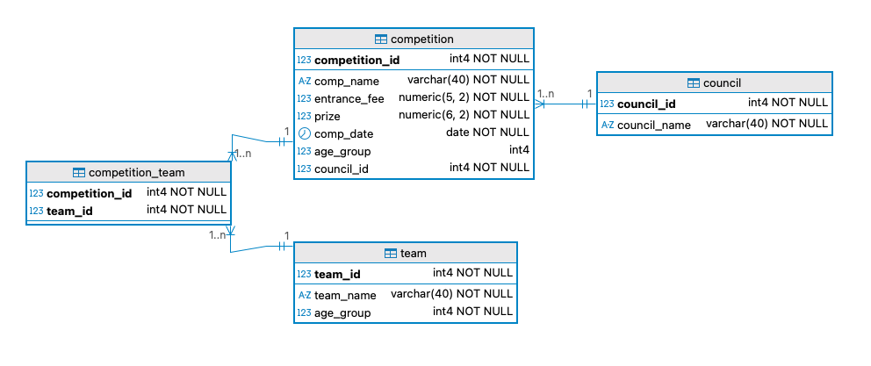
Our example

Slide 35
Parent and Child entities
Parent entity
An entity that contributes one or more attributes to another entity, called the parent.
In a one-to-many relationship the parent is the entity on the "one" side.
Child entity
An entity that derives one or more attributes from another entity, called the child.
In a one-to-many relationship the child is the entity on the "many" side.
Notes:
Teaching Notes
These concepts are illustrated on the next slide.

Slide 36
Data Modeling: One to one in pgadmin
Pgadmin is an open-source, free database management system that allows us to build ERDs using forward engineering
However, pgadmin considers one-to-one relationships a special case of one-to-many relationships
There is no representation of one to one in the pgadmin notation
We can work around that by making the FK on the table at the many side a UNIQUE value
For example: build an ERD for two tables that include information about employees and company_cars, considering that each employee can have only one car assigned to them.
Notes:
Teaching Notes
These concepts are illustrated on the next slide.

Slide 37
